Slide 1


DESIGN AND VERIFICATION OF RLC AM AND UM MODES IN 5G NR
A Conformance and Performance Analysis Based on 3GPP TS 38.322

Slide 2

PROJECT OBJECTIVE & SCOPE
TO DESIGN AND EXECUTE TEST SCENARIOS TO VERIFY THE PERFORMANCE OF THE 5G RLC LAYER AGAINST THE 3GPP STANDARD.
01
Core Tasks
Simulate RLC PDU handling as defined in Section 6.2 of TS 38.322.
Measure Key Performance Indicators (KPIs) like Throughput, Latency, and Retransmission Rate.
Analyze the behavior of RLC's primary data transfer modes.
02
Scope
This project focuses on Acknowledged Mode (AM) and Unacknowledged Mode (UM), the two most critical modes for user data transfer.

Slide 3

WHY TEST RLC?
THE IMPORTANCE OF RELIABLE DATA DELIVERY
The 5G Challenge:
Why We Test:
The air interface is inherently unreliable. The RLC layer is designed to fix this.
We ensure the implementation correctly provides the "services to upper layers" described in Section 4.3 of the standard.

Slide 4
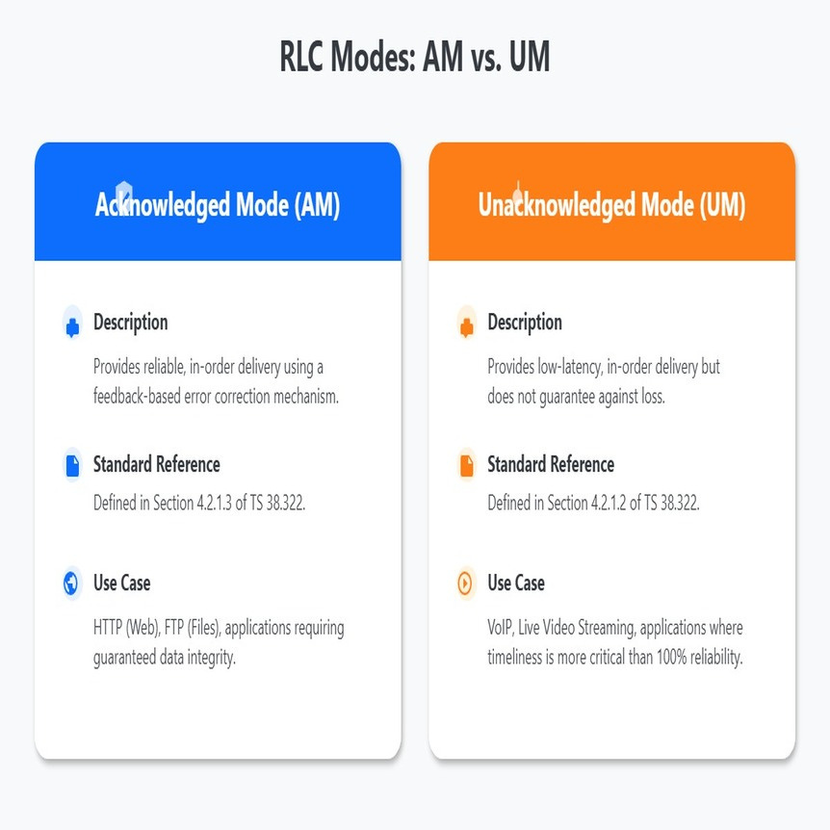
RLC MODES: AM
VS UM
INTRODUCING THE RLC MODES
01
Acknowledged Mode (AM)
Description: Provides reliable, in-order delivery using a feedback-based error correction mechanism.
Standard Reference: Defined in Section 4.2.1.3 of TS 38.322.
Use Case: HTTP (Web), FTP (Files), applications requiring guaranteed data integrity.
02
Unacknowledged Mode (UM)
Description: Provides low-latency, in-order delivery but does not guarantee against loss.
Standard Reference: Defined in Section 4.2.1.2 of TS 38.322.
Use Case: VoIP, Live Video Streaming, applications where timeliness is more critical than 100% reliability.

Slide 5
UNACKNOWLEDGED MODE : THE "SPEED FIRST" APPROACH
Core Principle: Prioritize low latency by eliminating the delay of feedback and retransmissions.
PDU Structure (TS 38.322, Sec 6.2.2.3):
An UMD PDU consists of a header and a data field.
The header is simple, containing a Sequence Number (SN) and Segmentation Info (SI).
The SN can be 6 or 12 bits, configured by RRC, defining the window size for reordering.
The 2-bit SI field indicates if the PDU contains a full SDU, a first segment, a last segment, or a middle segment.
Key Limitation: As per the standard, there is no mechanism for the receiver to request retransmission of a lost UMD PDU.

Slide 6
HOW UM WORKS: SEGMENTATION & REASSEMBLY
Segmentation (Sender Side):
When an SDU arrives, the sender checks if it fits in a single PDU.
If not, it segments the SDU. It creates the first PDU with SI = '01' (first segment), middle PDUs with SI = '11', and the final PDU with SI = '10' (last segment). Each segmented PDU gets the same SN.
Reassembly (Receiver Side - TS 38.322, Sec 5.2.2.2):
The receiver uses the SN to reorder incoming PDUs.
The t-Reassembly timer is crucial. If the receiver has some segments of an SDU but not all, it starts this timer.
If the timer expires before the missing segments arrive, the receiver must discard all received segments of that SDU. This is the defined behavior for handling data loss in UM.

Slide 7
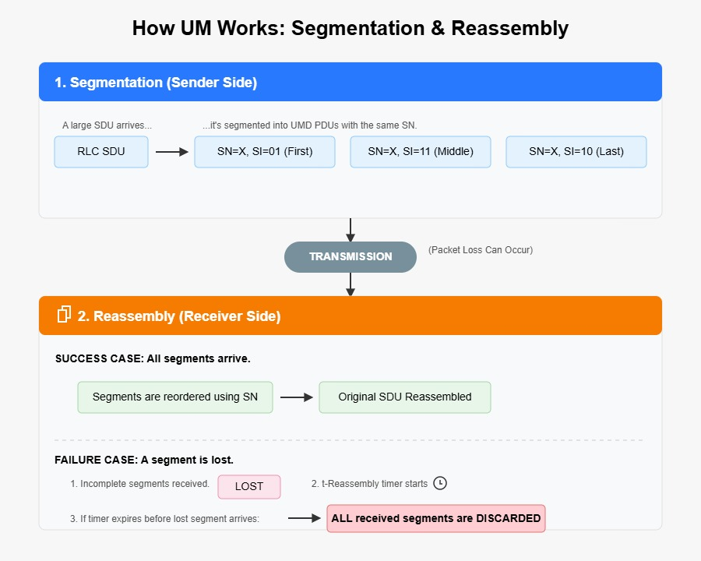
HOW UM WORKS: SEGMENTATION & REASSEMBLY

Slide 8
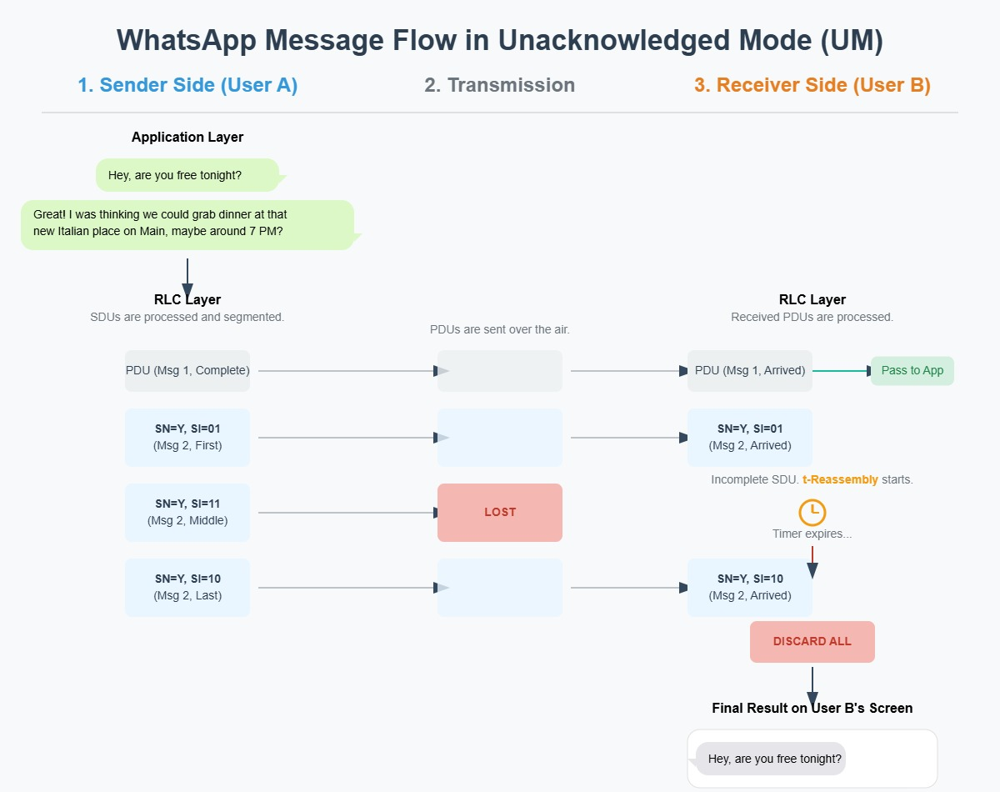

Slide 9
ACKNOWLEDGED MODE (AM): THE "RELIABILITY FIRST" APPROACH
Core Principle: Achieve error-free delivery through a closed-loop feedback system.
PDU Structure (TS 38.322, Sec 6.2.2.4):
An AMD PDU header is more complex. It contains a D/C (Data/Control) bit, a P (Poll) bit, SI, and a longer SN (12 or 18 bits).
The longer SN supports a much larger transmission window, essential for high-speed 5G links.
Key Mechanism: ARQ (Automatic Repeat reQuest), a protocol built on a constant dialogue between the sender and receiver

Slide 10
HOW AM WORKS: THE ARQ FEEDBACK LOOP
1. Status Reporting (Receiver's Feedback):
The receiver sends a STATUS PDU (identified by D/C bit = '0').
This PDU contains an ACK_SN to confirm reception up to a point, and one or more NACK_SN fields to report specific gaps.
It can even report partial gaps using SOstart / SOend fields for maximum efficiency.
2. Polling (Sender's Request for Feedback - Sec 5.3.3):
The sender sets the P-bit to '1' in an AMD PDU header to request a status report.
This is triggered by configurable parameters like pollPDU (number of PDUs sent) or pollByte (volume of data sent).
3. Retransmission (Sender's Corrective Action - Sec 5.3.2):
Upon receiving a STATUS PDU, the sender inspects the NACKs.
It retrieves the missing data from its buffer and schedules it for retransmission, prioritizing it over new data.
The RETX_COUNT for that SDU is incremented. If it reaches maxRetx Threshold, the SDU is discarded and upper layers are notified.

Slide 11
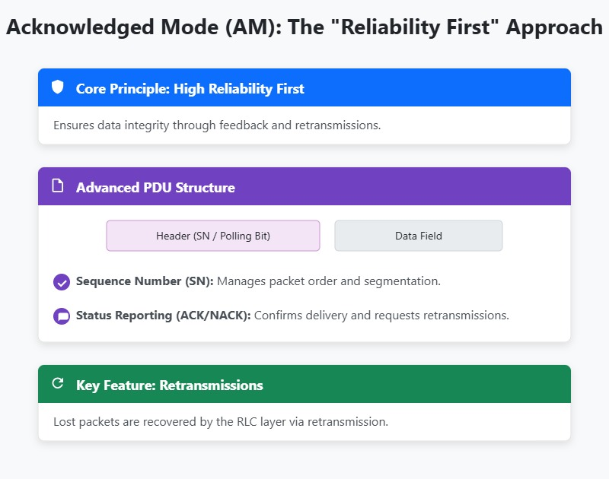

Slide 12
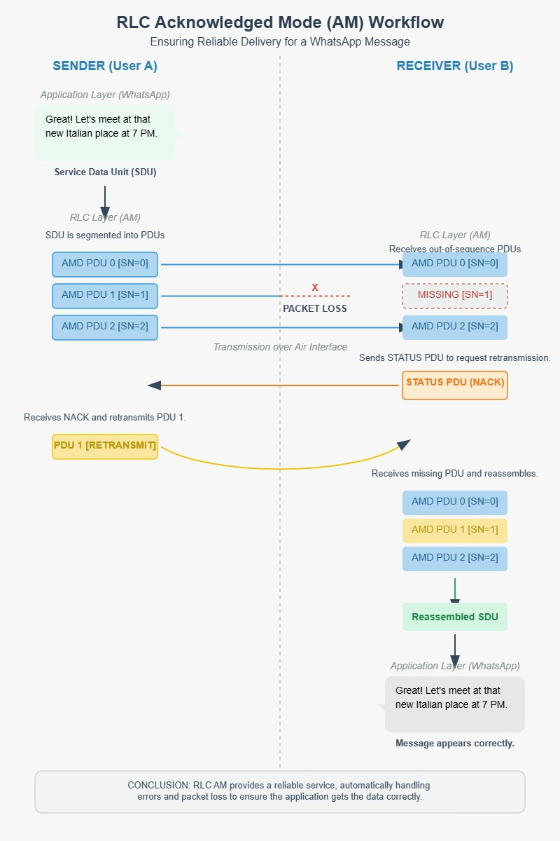

Slide 13
THE ARQ CONVERSATION: KEY TIMERS
t-Poll Retransmit (Sender Side): This is the sender's watchdog timer. When a poll is sent, this timer starts. If it expires before a STATUS PDU is received, the sender assumes the report was lost and initiates a new poll/retransmission. This prevents deadlocks.
t-Reassembly (Receiver Side): The receiver's patience timer. If it has an incomplete SDU and waits too long for the missing pieces, this timer expires, triggering it to send a STATUS PDU to complain about the gaps.
t-Status Prohibit (Receiver Side): Prevents the receiver from spamming STATUS PDUs. After sending one, it cannot send another until this timer expires, even if new errors are detected. This reduces control plane overhead.

Slide 14

TEST SETUP & METHODOLOGY
Configure
Inject
Simulate
Set up the RLC entity in either AM or UM mode, with parameters like SN size, window size, and timer values.
Feed a stream of SDUs into the RLC sender.
Pass the resulting PDUs through a channel with pre-defined, repeatable packet loss patterns.
Monitor & Log
Analyze
Capture detailed logs of PDU transmission/reception, timer starts/stops, and buffer states.
Process logs to calculate KPIs and compare behavior against the standard.

Slide 15

KEY PERFORMANCE INDICATORS (KPIS) TO MEASURE
01
Latency (ms)
The time from when an SDU is passed to the RLC sender until it is successfully delivered by the RLC receiver.
02
Application Packet Loss Rate (%)
The percentage of SDUs that were discarded by the RLC layer (either due to maxRetxThreshold in AM or reassembly failure in UM).
03
RLC Retransmission Rate (%)
The ratio of retransmitted PDUs to total transmitted PDUs.

Slide 16

UNACKNOWLEDGED AND ACKNOWLEDGE MODE (UM) TEST CODE & RESULTS

Slide 17
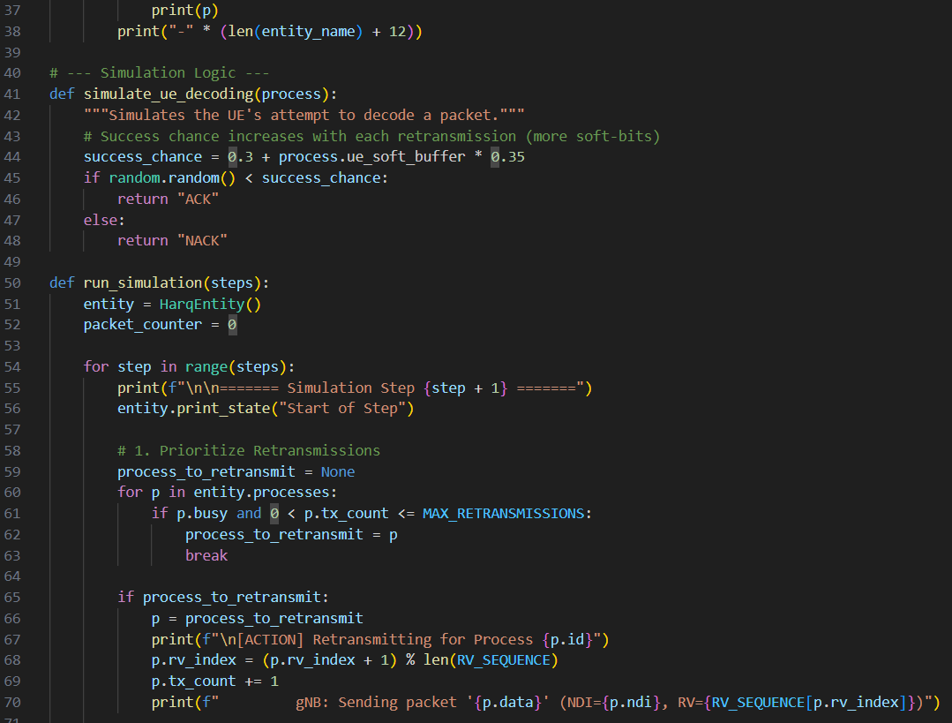
TESTS
CASE
CODE

Slide 18
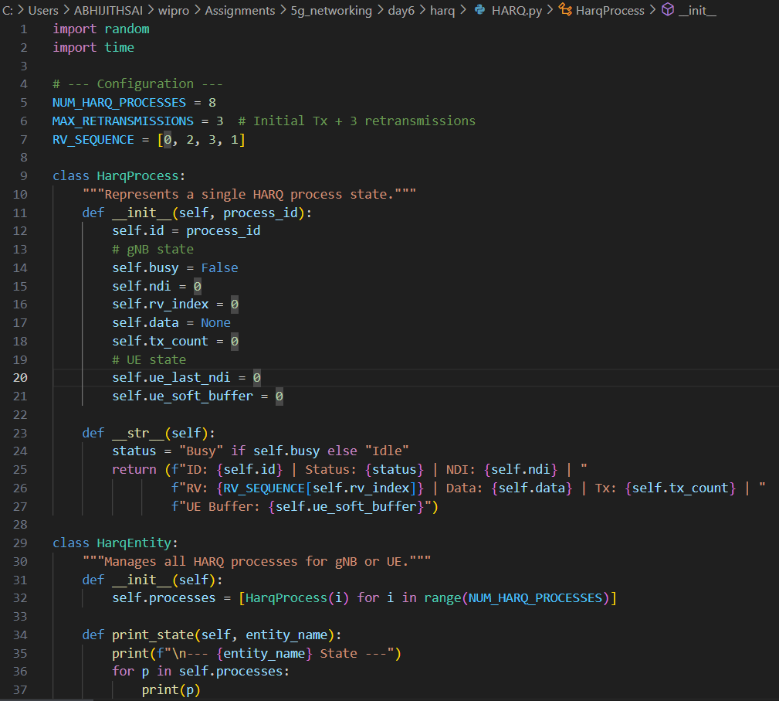
TESTS
CASE
CODE

Slide 19
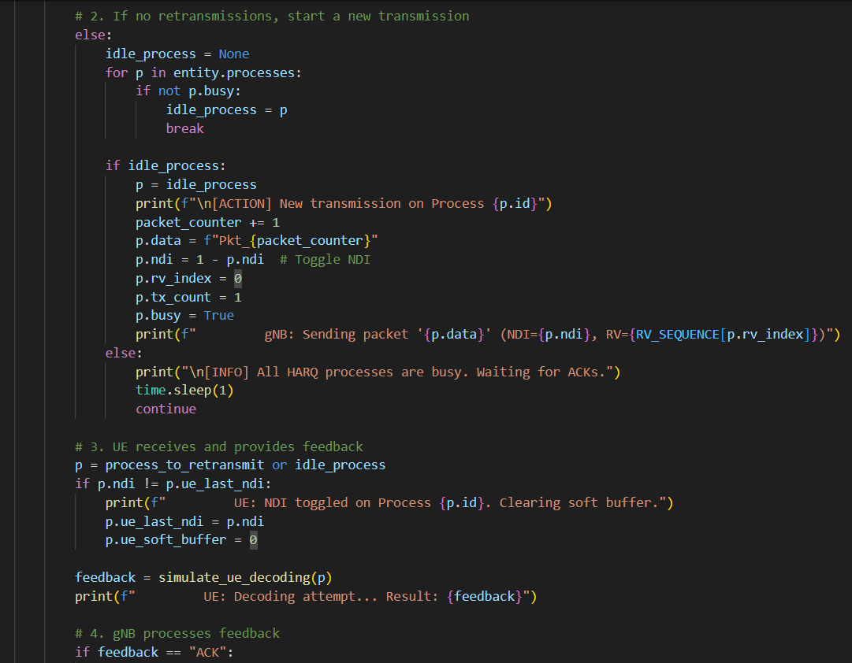
TESTS
CASE
CODE

Slide 20
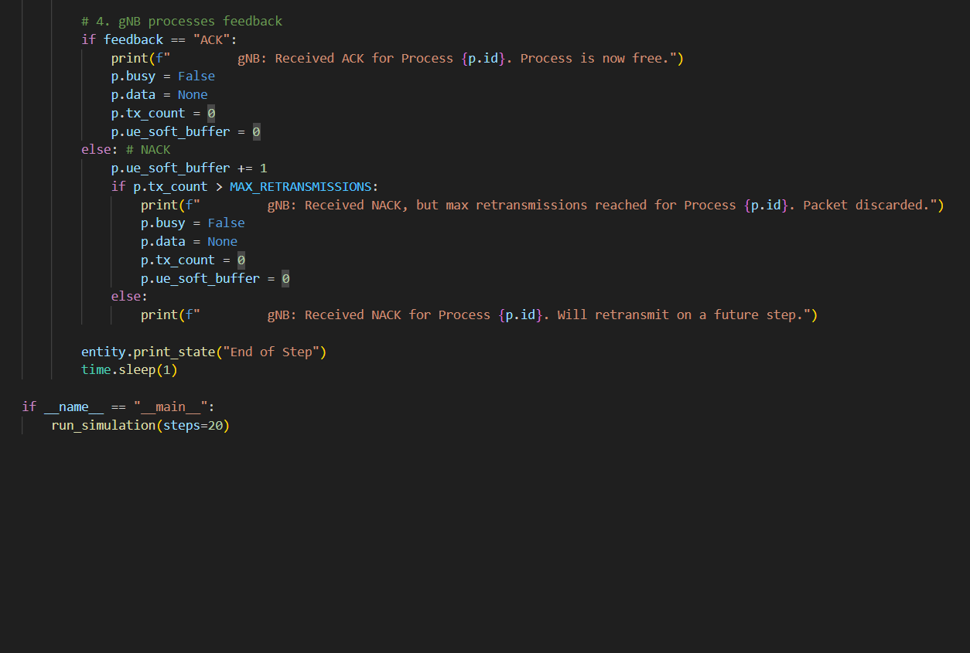
TESTS
CASE
CODE

Slide 21
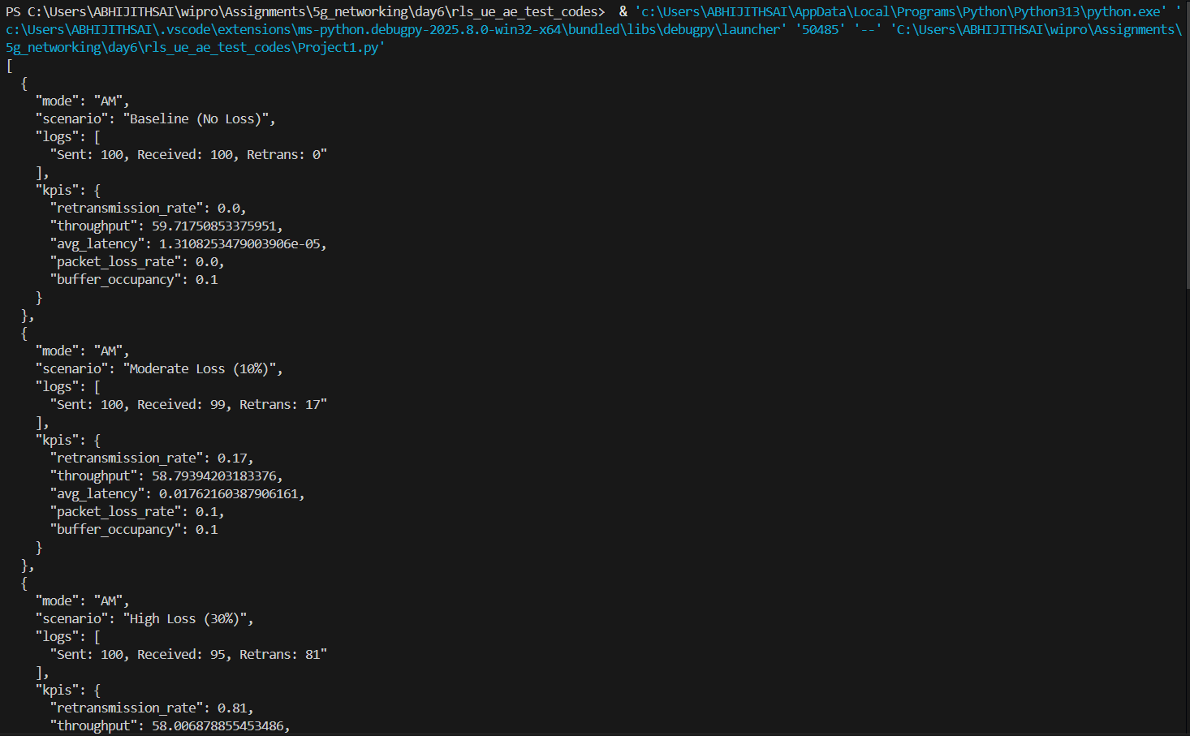
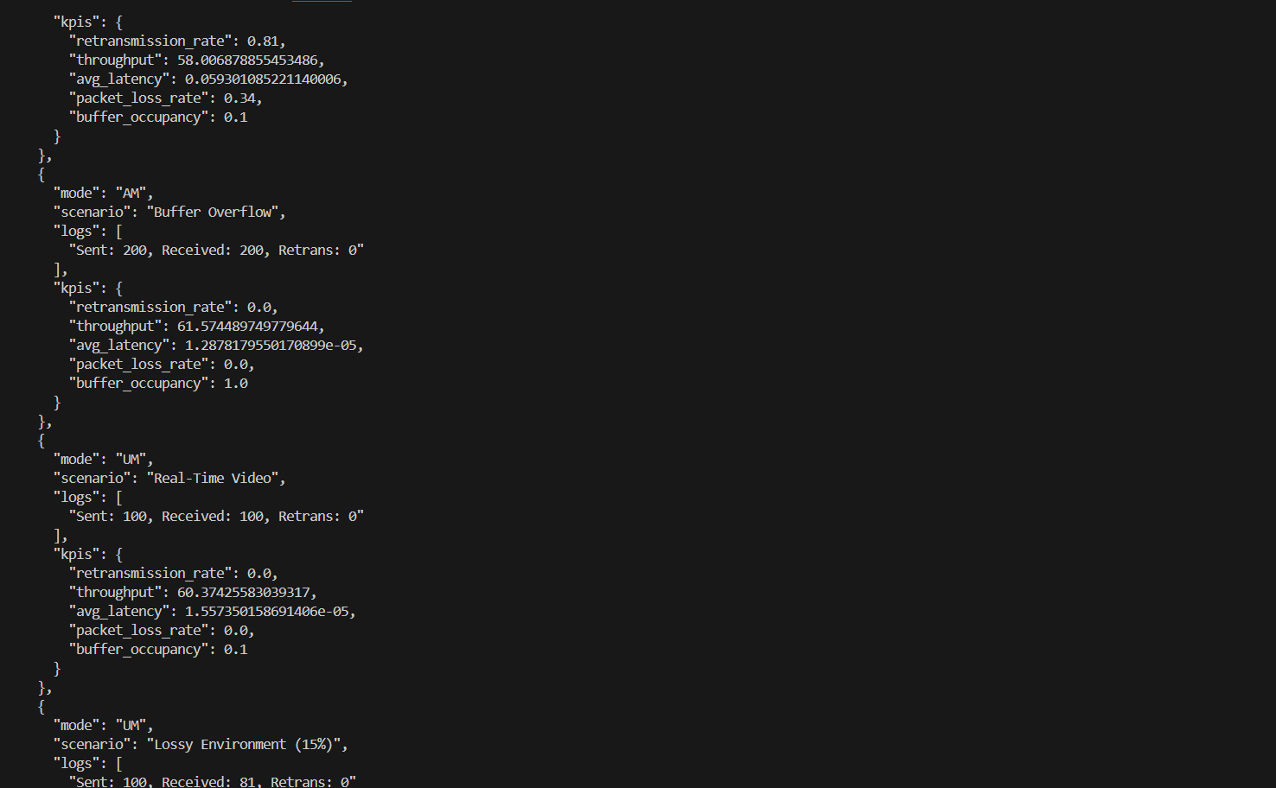
TESTS
CASE
RESULT

Slide 22
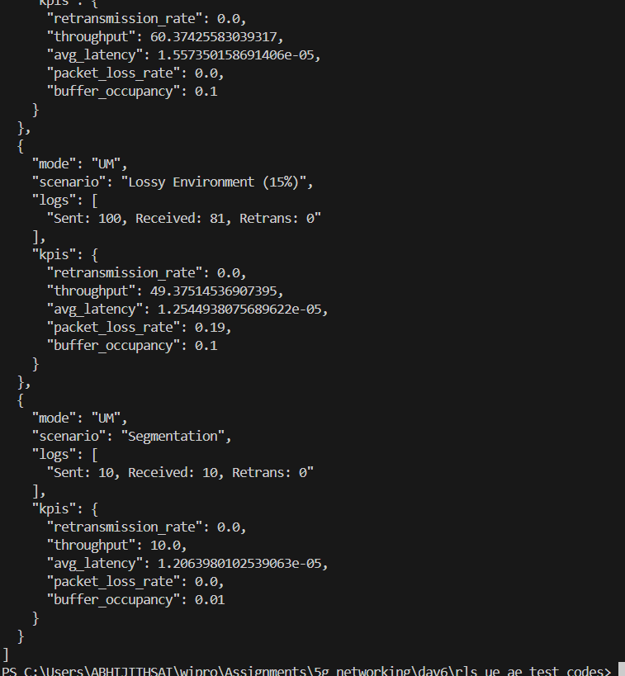
TESTS
CASE
RESULT

Slide 23
CONCLUSION & FUTURE WORK
Conclusion: This project successfully designed a test framework and used it to verify the functionality and quantify the performance of RLC AM and UM modes. The results demonstrate that the implementation conforms to the 3GPP standard and performs as expected.
Future Work:
Handover Testing: Test RLC re-establishment procedures (Section 5.1.2), which are critical for mobility.
Parameter Tuning: Analyze the performance impact of changing configurable parameters like t-PollRetransmit and maxRetxThreshold.
Advanced Scenarios: Introduce scenarios with sidelink communication (V2X) or for MBS (Multicast Broadcast Services), which also use RLC.

